Slide 1
University of Houston Internship Summary
Krish Advani
Internship with Dr. Peggy Lindner
May-June 2024

Slide 2
Table of Contents
Internship Overview
Starting with Data Analysis using Pandas (Python)
Types of Classification Algorithms
Regression Models
Naïve Bayes
K-Nearest Neighbors (KNN)
Decision Trees
Topic Modeling
Real World Usage of Classification
Applications in Human Health using regression
Sentiment Analysis using Naïve Bayes
Recommendation Algorithms using KNN
Fraud Detection using Decision Trees
Conclusion & Next Steps

Slide 3
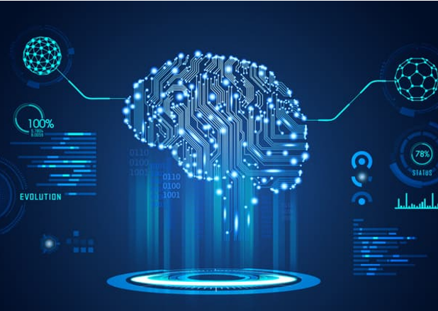
Internship Overview
The objective of my internship was to research and learn about various artificial intelligence classification algorithms and utilize them to perform text categorization like sentiment analysis and intent classification.
My internship with Dr. Peggy Lindner lasted 4 weeks, where I spent 18 hours a week at the data science research lab in the University of Houston.
The specific models and algorithms that I learned about and used during my internship are explained in the following slides.

Slide 4
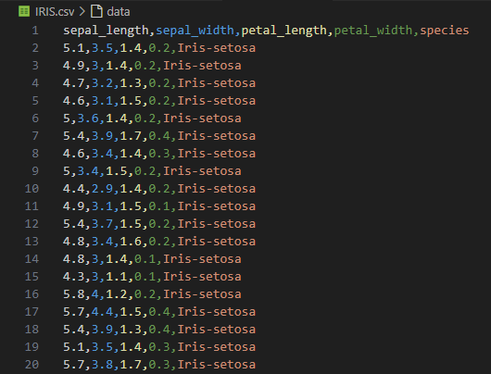
Using Data Science in Python with Pandas
Pandas is a library in python used for data manipulation and analysis.
During my internship, I learned how to use pandas to read and manipulate data sets in order to use the contents for training AI models.
The data sets that I used in my programs were Comma Separated Values (CSV). I used pandas to read and load these values into models and train them to classify prompts.
When utilizing data sets for AI models, a train-test split can be used that splits data and uses a portion of it to train the model and the other portion to test it.
This is an example of a data set in CSV format called the Iris flower dataset that I used to train and test one of my AI models.
The foundational capability for data science and artificial intelligence is the ability to consume and manipulate data.

Slide 5
Types of Classification Algorithms

Slide 6
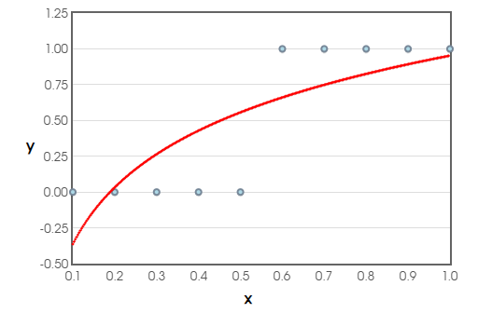
Logarithmic/Linear Regression
Regression analysis enables precise prediction and insightful understanding of relationships between variables, which is keystone in the field of data science
Linear Regression is an algorithm that classifies prompts through a linear equation based on y=mx+b.
Given a data set, the linear regression algorithm models a linear function to best match the data and will use that function to predict and categorize prompts.
Logarithmic Regression works the same way, but it models after the equation y=alog(x)+b.
Logarithmic Regression is often used for binary categorization, which is when the predication categories are yes or no (ie. sick or not).
This is a graph displaying a logarithmic regression modeled after a small dataset I created. The curve symbolizes the regression equation that is used to make predictions.

Slide 7

Naive Bayes Text Classification
The Naive Bayes algorithm’s assumption of feature independence and usage of the Bayes’ Theorem allows for faster training and testing, but it comes at the cost of accuracy.
Naive Bayes is a classifier algorithm that is often used for text classification.
The algorithm uses Bayes’ Theorem to estimate probabilities of prompts fitting into categories based on data sets.
Bayes Theorem: $P\left(A | B\right)=\frac{P(B|A)∗P(A)}{P\left(B\right)}$
A disadvantage of the Naive Bayes algorithm is that it assumes feature independence, meaning that a particular feature in a class is independent of the presence of any other feature in the same class. For example, in text categorization, Naive Bayes examines each word as a separate, independent document.
This is the link to a program I made that uses the Naïve Bayes algorithm to classify questions into different categories based on a dataset.

Slide 8
K-Nearest Neighbors Classification
K-Nearest Neighbors classifies data points by leveraging the proximity of their neighbors, incorporating distance and geometry into data science.
K-Nearest Neighbors (KNN) is a classification algorithm that clusters points based on the distance between them.
K is the amount of data points that are compared to the prompt value. Out of these data points, the majority category will be selected as the output.
In my internship, I created a program that used the KNN algorithm to classify Iris flowers into 3 different categories based on their measurements.
This is the link to a program I made that uses the KNN algorithm to classify inputs of dimensions into three different iris flowers. It uses the Iris dataset.

Slide 9
Decision Trees Classification
Decision Trees enable intuitive and effective decision-making by splitting data into interpretable branches based on feature values.
Decision Trees are a type of classification algorithm that categorizes prompts by splitting them into nodes based on conditionals.
Decision Trees have nodes, branches, and leaves, and they use the training data to develop conditions in order to classify prompts.
The conditional approach for decision trees allow for quicker training and testing times compared to other algorithms.
A disadvantage with Decision Trees is that they have high variance. This means that small changes in the training data can result in a completely different tree being generated, making Decision Trees less stable compared to other models.

Slide 10
Topic Modeling
Topic modeling uncovers shared themes in large text documents, grouping unstructured data into meaningful categories.
Topic Modeling is used to identify abstract topics within a collection of documents. It is encapsulated in generative AI, as it is able to generate and group documents together based on similarities and probabilities.
One common algorithm used for topic modeling is Latent Dirichlet Allocation (LDA). LDA assumes documents are mixtures of topics and topics are mixtures of words, and it generates new documents by sampling from the distribution of topics and words.
During my internship, I used topic modeling to identify groups from a set of 100 prompts using the LDA algorithm.
This is the link to a program I made that uses the LDA algorithm to make groups based on similarities found from a dataset of 100 prompts

Slide 11
Real World Uses of Classification

Slide 12
Predicting Health with Regression Models
Using regression models can help with predicting health patterns and human activities such as diseases and conditions.
Researchers can apply regression models to find and predict patterns in human health.
By using regression to identify the relationship between variables connected to human health, they can make predictions to improve and optimize their treatments.
For example, doctors could use regression models to identify the relationship between age and disease incidence and adjust their treatments according to the findings.

Slide 13
Sentiment Analysis using Naive Bayes
Sentiment analysis, a crucial tool in data science and AI, transforms raw text into actionable insights by detecting and interpreting emotions and opinions.
Sentiment Analysis is used to determine the connotation of a prompt (positive/neutral/negative).
During my internship, I learned how to use the Naive Bayes algorithm to perform sentiment analysis on prompts through probabilities and comparisons.
Sentiment Analysis is often used in spam detectors. AI models are trained using classification algorithms that perform Sentiment Analysis on emails and classify them as either spam or not.

Slide 14
Recommendation Systems using KNN
K-Nearest Neighbors use distances from data points to assist platforms in recommending items based on provided data
K-Nearest Neighbors can be used to recommend new items based on other data points.
By utilizing the distances between data points of items, KNN can be utilized to recommend similar things.
For example, many streaming services utilize KNN to recommend new titles after their customers watch movies or shows by comparing the distance between each title.

Slide 15
Fraud Detection using Decision Trees
Decision Trees can be utilized to detect fraud and identity theft by identifying patterns in transaction data.
Fraud can be detected with the help of decision trees and transaction data.
By splitting transaction data into leaves and nodes using tailored conditions, a prediction can be made about whether a transaction is fraudulent or not.
By utilizing the conditional categorization with decision trees, fraud can easily be detected

Slide 16

Conclusion
Ultimately, my internship with Dr. Lindner helped me to learn and apply AI classification algorithms to real world data sets. Through the internship, I have gained a deeper understanding of AI and data science, and I hope to continue to develop my knowledge in the field.
In the future, I plan to work more with Dr. Lindner during the school year as well as begin a project using text classification. I also plan to research more about AI algorithms and data science on my own and implement my knowledge into real world models.

